Slide 1




Lesson 2: Installing Domain Controllers
MOAC 70-410: Installing and Configuring Windows Server 2012

Slide 2

Overview
Exam Objective : Install Domain Controllers
Introducing Active Directory
Deploying Active Directory Domain Services

Slide 3


Introducing Active Directory
Lesson 13: Installing Domain Controllers

Slide 4


Introducing Active Directory
A directory service is a repository of information about the resources—hardware, software, and human—that are connected to a network.
Users, computers, and applications throughout the network can access the repository for a variety of purposes:
  User authentication
  Storage of configuration data
  Accessing files and printers

Slide 5


Active Directory Domain Services (AD DS)
AD DS is a directory service that enables administrators to create organizational divisions called domains
A domain is a logical container of network components, hosted by at least one server designated as a domain controller.

Slide 6


Active Directory Functions
Authentication is the process of verifying a user’s identity by using:
  Passwords
  Smart cards
  Biometrics (fingerprint scan)
Authorization is the process of granting the user access only to the resources he or she is permitted to use by using:
  ACLs and ACEs

Slide 7


The Active Directory Architecture
Active Directory is a hierarchical directory service, based on the domain, which is scalable in both directions.
You can subdivide a domain into organizational units and populate it with objects.
You can create multiple domains and group them into sites, trees, and forests.
AD DS provides a highly flexible architecture that can accommodate the smallest and the largest organizations.

Slide 8

Objects and Attributes
An AD DS domain is a hierarchical structure that takes the form of a tree, much like a file system.
Consists of objects, each of which represents a logical or physical resource.
Each object consists of attributes which store information about the object.
Different objects have different attributes, depending on their function.
The directory schema defines the attributes for each object and the information that is required and optional.

Slide 9
Classes of Objects
A container object can have other objects subordinate to it:
Domain
Organizational unit
A leaf object cannot have subordinate objects:
Users
Computers
Groups
Applications
Network resources

Slide 10

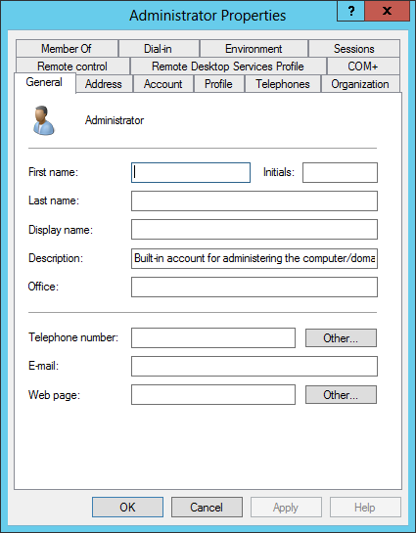
Objects and Attributes
The attributes of a user object, as displayed in its Properties sheet

Slide 11

Domains
You can create a hierarchy within a domain.
You can create a hierarchy out of multiple domains.
You begin the process of designing an Active Directory infrastructure by deciding what domains to create and you begin deploying AD DS by creating your first domain.

Slide 12

Organizational Units (OUs)
Are container objects within a domain, used to divide the security and administrative responsibility among several divisions or departments
Function in a subordinate capacity to a domain, like a subdomain, but without the complete separation of security policies
Can contain other OUs, as well as leaf objects
Can have separate Group Policy settings applied to them

Slide 13

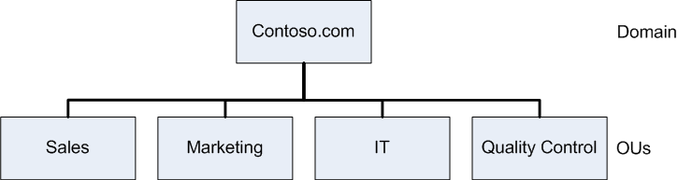
Organizational Units
Organizational units subordinate to a domain

Slide 14

Groups
Group objects contain users (from a single or multiple domains or OUs) who require similar access to resources or rights to perform tasks.
Members of a group inherit rights and permissions assigned to the group.

Slide 15

Domain Trees (1)
When you create your first domain on an Active Directory network, you are creating the root of a domain tree.
You can populate the tree with additional domains, as long as they are part of the same contiguous namespace.
When using registered Internet domain names, subdomains can be used to create other domains within the domain tree.

Slide 16

Domain Trees (2)
You can add as many domains to the tree as you need.
Each domain in a tree is a separate security entity with its own separate Group Policy settings, permissions, and user accounts.
Unlike OUs, subdomains in a tree do not inherit permissions and policies from their parent domains.
Domains in the same tree have bidirectional trust relationships between them, which means that an administrator of a particular domain can grant any user in the tree access to that domain’s resources.

Slide 17

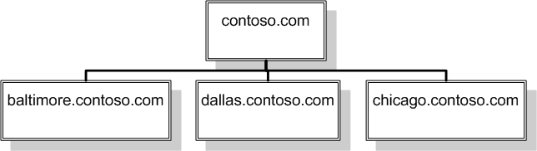
Domain Trees
An internal Active Directory domain tree

Slide 18
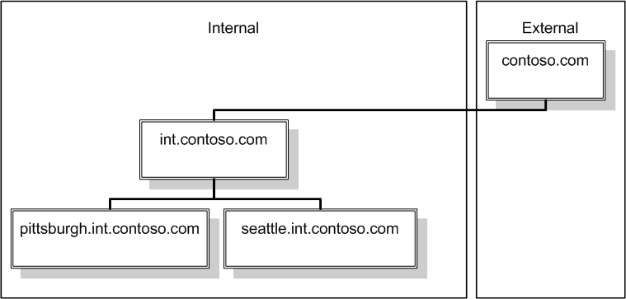
Domain Trees
An Active Directory domain tree using an Internet domain name

Slide 19

Forests
An Active Directory forest consists of one or more separate domain trees, which have the same two-way trust relationships between them as two domains in the same tree.
When you create the first domain on an Active Directory network, you are creating a new forest, and that first domain becomes the forest root domain.

Slide 20

Global Catalog
Each forest has a global catalog, which is a list of all of the objects in the forest, along with a subset of each object’s attributes.

Slide 21

Functional Levels
Functional levels are designed to provide backwards compatibility in AD DS installations with domain controllers running various versions of the Windows Server operating system.
By selecting the functional level representing the oldest Windows version running on your domain controllers, you disable the new features so that the various domain controllers can interoperate properly.

Slide 22

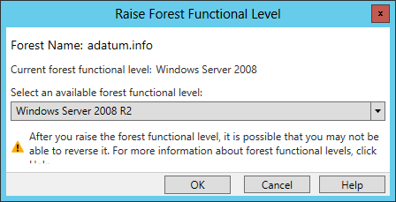
Functional Levels
Raising functional levels

Slide 23

Active Directory Communications
Active Directory services are implemented in the network’s domain controllers.
Each domain controller hosts one domain, storing the domain’s objects in a database.
Users and computers that are members of a domain access the domain controller frequently, as they log on to the domain and access domain resources.
You should have at least two domain controllers to ensure the Active Directory database is available to clients at all times.

Slide 24

Introducing LDAP
Lightweight Directory Access Protocol (LDAP) has become the standard communications protocol for directory service products, including Active Directory.
Defines the format of the queries that Active Directory clients send to domain controllers.
Provides a compound naming structure for uniquely identifying objects in the directory.

Slide 25

Replication
Replication is when domain controllers within a domain synchronize their database information.
It is imperative that each domain controller has a database that is identical to the others.

Slide 26

Types of Replication
Single-master replication: A single primary system replicates the contents of its database to one or more secondary systems on the network.
Multiple-master replication: It is possible to make changes to domain objects on any domain controller, which replicates those changes to all of the other domain controllers.

Slide 27

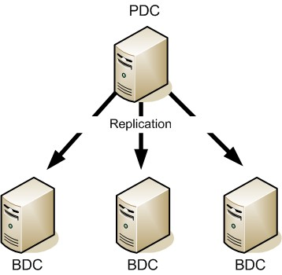
Replication
Single-master replication

Slide 28
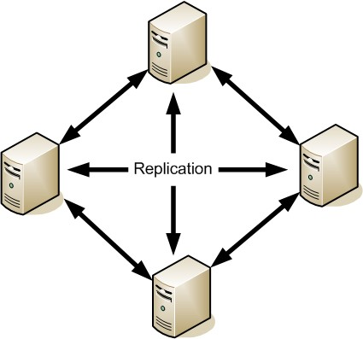
Replication
Multiple-master replication

Slide 29




Read-Only Domain Controllers (RODCs)
A domain controller that supports only incoming replication traffic.
It is not possible to create, modify, or delete Active Directory objects.
Intended for use in locations that require a domain controller, but which have less physical security or where there are no administrators present who need read/write access to the Active Directory database.

Slide 30

Sites (1)
A site is a collection of subnets that have good connectivity between them.
Generally speaking, this means that a site consists of all the local area networks (LANs) at a specific location.
A different site would be a network at a remote location, connected to the other site using a T-1 or a slower WAN technology.

Slide 31

Sites (2)
Site divisions are wholly independent of domain, tree, and forest divisions:
  You can have multiple sites that are part of a single domain.
  You can have separate domains, trees, or forests for each site.
The primary reason for creating different sites on an Active Directory network is to control the amount of traffic passing over the relatively slow and expensive WAN links between locations.

Slide 32

Site Topology
A site topology consists of three AD DS object types:
Sites: A site object represents the group of subnets at a single location, with good connectivity.
Subnets: A subnet object represents an IP network at a particular site.
Site links: A site link object represents a WAN connection between two sites.

Slide 33


AD DS Regulatory Functions
Once the site topology is in place you can make decisions about:
Domain controller location
Replication traffic control

Slide 34


Deploying Active Directory Domain Services
Lesson 13: Installing Domain Controllers

Slide 35

Deploying AD DS
There are many variables that can affect the performance of an Active Directory installation:
The hardware you select for your domain controllers
The capabilities of your network
The types of WAN links connecting your remote sites

Slide 36

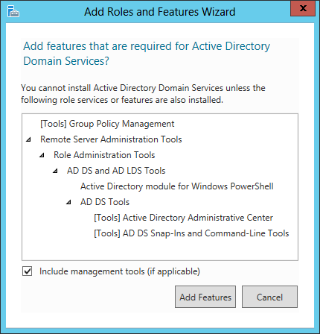
Installing the AD DS Role
The Add features that are required dialog box in the Add Roles and Features Wizard

Slide 37
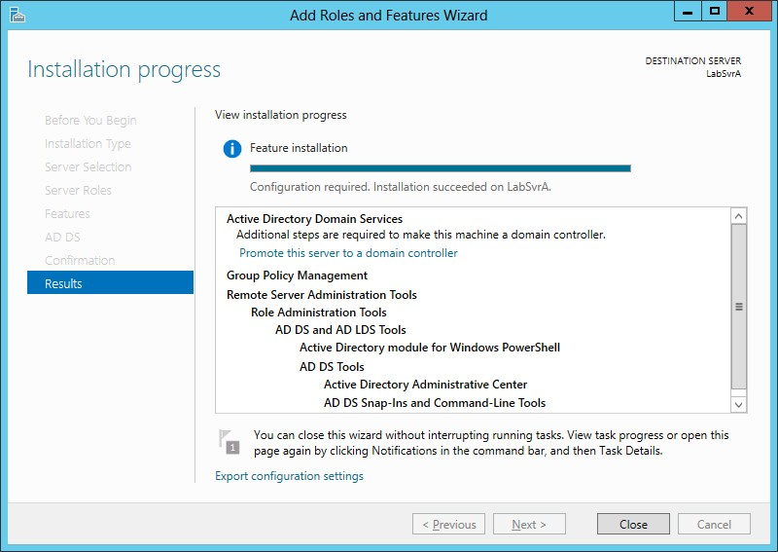
Installing the AD DS Role
The Installation progress page in the Add Roles and Features Wizard

Slide 38

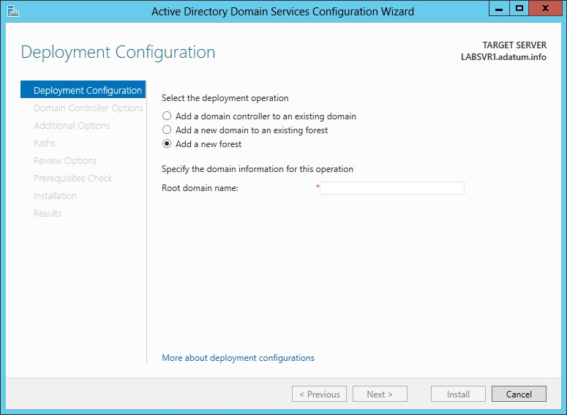
Creating a New Forest
The Deployment Configuration page of the Active Directory Domain Services Configuration Wizard

Slide 39
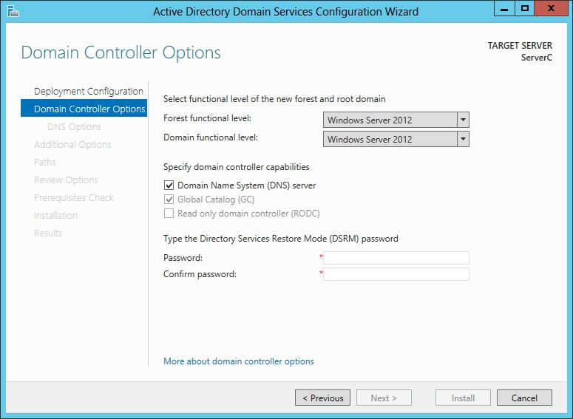
Creating a New Forest
The Domain Controller Options page of the Active Directory Domain Services Configuration Wizard
© 2013 John Wiley & Sons, Inc.

Slide 40
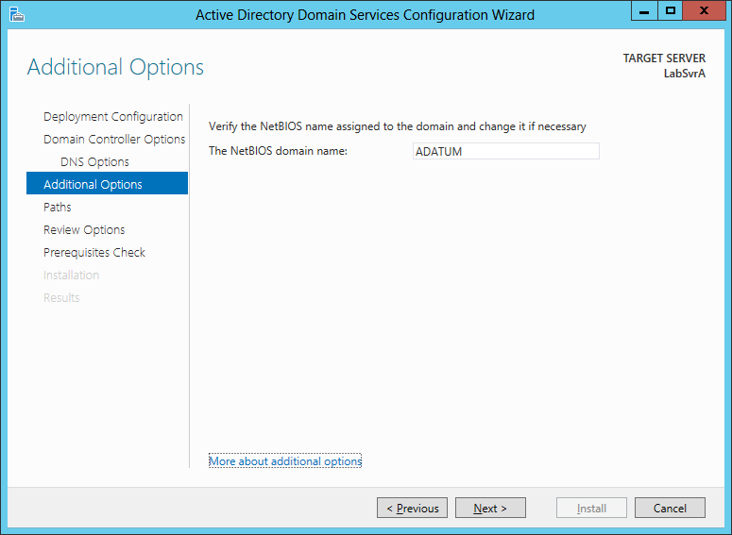
Creating a New Forest
The Additional Options page of the Active Directory
Domain Services Configuration Wizard
© 2013 John Wiley & Sons, Inc.

Slide 41
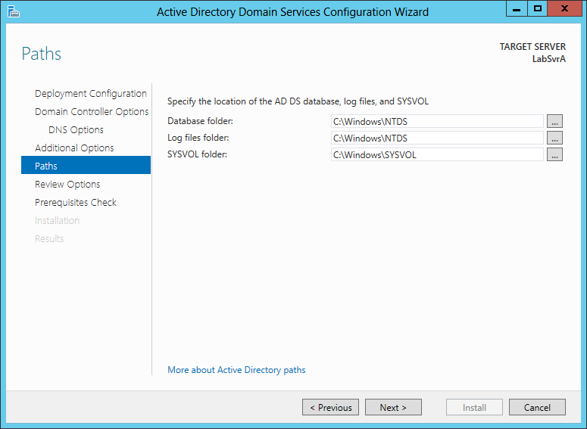
Creating a New Forest
The Paths page of the Active Directory Domain Services
Configuration Wizard

Slide 42
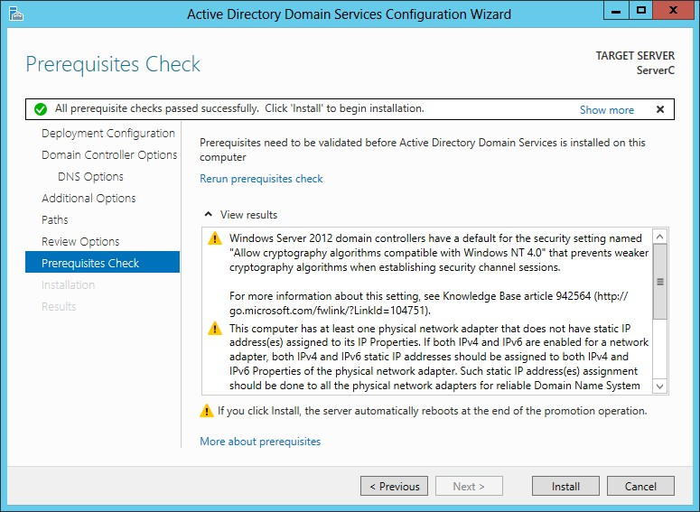
Creating a New Forest
The Prerequisites Check page of the Active Directory
Domain Services Configuration Wizard
© 2013 John Wiley & Sons, Inc.

Slide 43


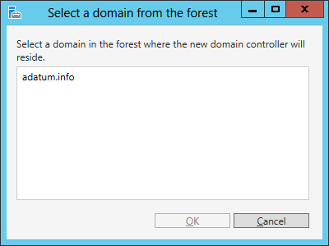
Adding a Domain Controller to an Existing Domain
The Select a domain from the forest page of the Active
Directory Domain Services Configuration Wizard
© 2013 John Wiley & Sons, Inc.

Slide 44
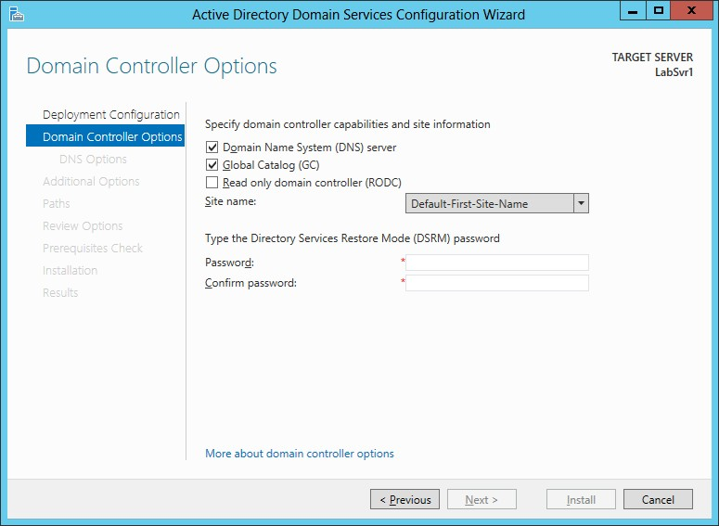
Adding a Domain Controller to an Existing Domain
The Domain Controller Options page of the Active
Directory Domain Services Configuration Wizard
© 2013 John Wiley & Sons, Inc.

Slide 45
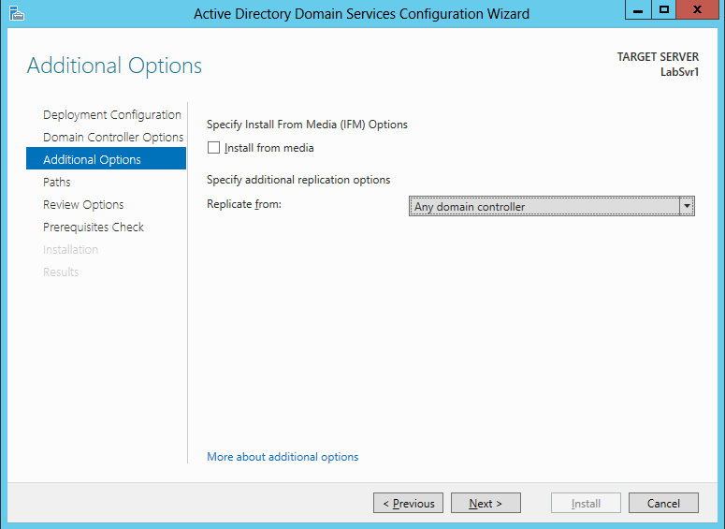
Adding a Domain Controller to an Existing Domain
The Additional Options page of the Active Directory
Domain Services Configuration Wizard
© 2013 John Wiley & Sons, Inc.

Slide 46


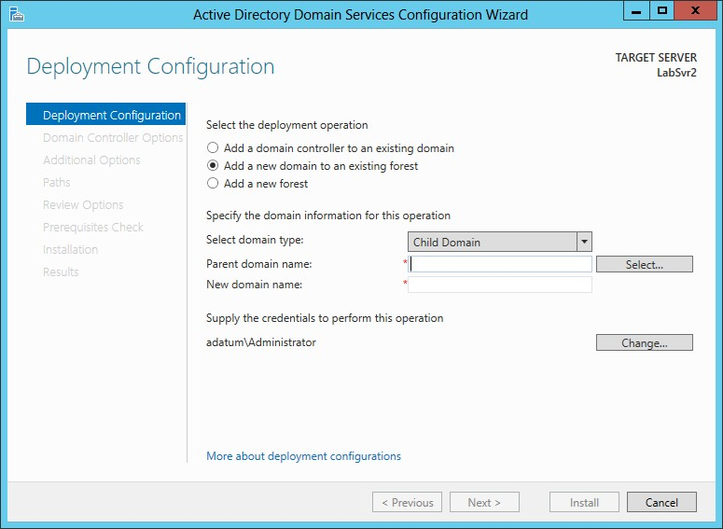
Creating a New Child Domain in a Forest
The Deployment Configuration page of the Active Directory Domain Services Configuration Wizard
46

Slide 47
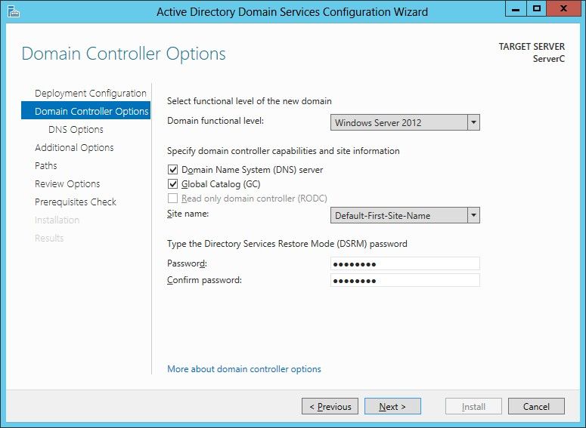
Creating a New Child Domain in a Forest
The Domain Controller Options page of the Active Directory Domain Services Configuration Wizard

Slide 48


Installing AD DS on Server Core
In Windows Server 2012, it is now possible to install Active Directory Domain Services on a computer running the Server Core installation option and promote the system to a domain controller, all using Windows PowerShell.
To Install the AD DS role, use the following command:
Install-WindowsFeature –name AD-Domain- Services -IncludeManagementTools

Slide 49
Installing AD DS on Server Core
After installing the role, you must promote the server to a domain controller using the ADDSDeployment PowerShell module.
There are three separate cmdlets for the three deployment configurations:
Install-AddsForest
Install-AddsDomainController
Install-AddsDomain

Slide 50

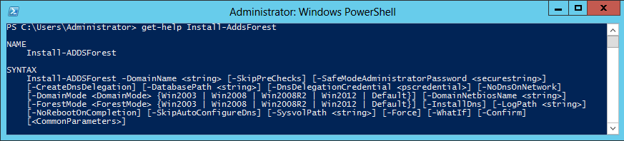
Installing AD DS on Server Core
Syntax for the Install-AddsForest cmdlet in
Windows PowerShell

Slide 51
Installing AD DS on Server Core
Another way to do this is to use a computer running Windows Server 2012 with the full GUI option to generate a script.
Begin by running the Active Directory Domain Services Configuration Wizard, configuring all of the options with your desired settings.
When you reach the Review Option page, click the View Script button to display the PowerShell code for the appropriate cmdlet.

Slide 52
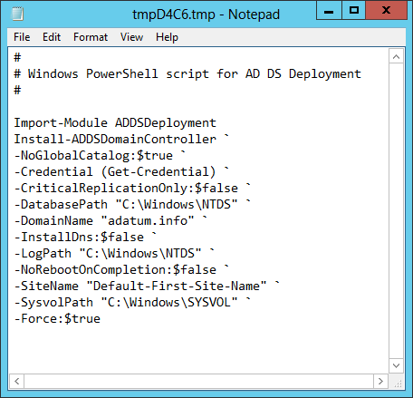
Installing AD DS on Server Core
An installation script generated by the Active Directory Domain Services Configuration Wizard

Slide 53

Install from Media (IFM)
Install from media is an option that enables administrators to streamline the process of deploying replica domain controllers to remote sites.
Using a command line tool called Ndtsutil.exe, administrators can create domain controller installation media that includes a copy of the AD DS database.
When using this installation media, the data is installed along with the database structure and no replication is needed.

Slide 54

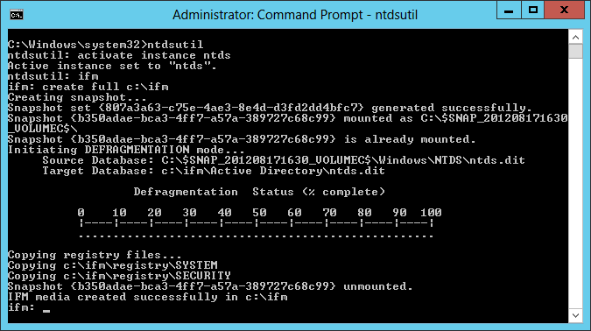
Install From Media (IFM)
An Ntdsutil.exe command sequence

Slide 55

Upgrading AD DS
Two ways to upgrade an AD DS infrastructure:
Upgrade the existing down-level domain controllers to Windows Server 2012.
Add a new Windows Server 2012 domain controller to your existing installation.

Slide 56


Removing a Domain Controller
To remove a domain controller from an AD DS installation, you must begin by running the Remove Roles and Features Wizard.
Select Demote this Domain Controller.

Slide 57
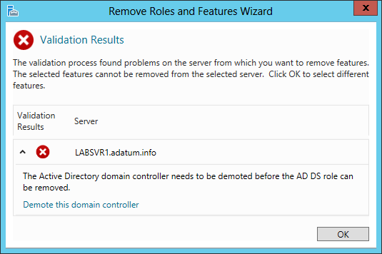
Remove a Domain Controller
The Validation Results dialog box of the Remove Roles and Features Wizard

Slide 58
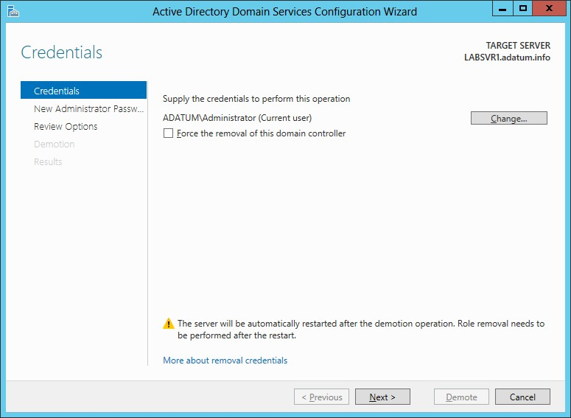
Remove a Domain Controller
The Credentials page of the Active Directory Domain Services Configuration Wizard

Slide 59
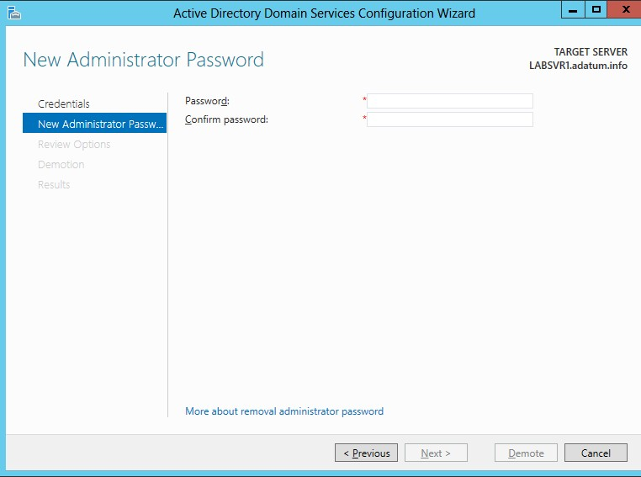
Remove a Domain Controller
The New Administrator Password page of the Active Directory Domain Services Configuration Wizard

Slide 60


Configuring the Global Catalog
The importance of the global catalog varies depending on the size of your network and its site configuration.
You can make a domain controller a global catalog server when you promote a server to a domain controller, or you can do it afterward.

Slide 61

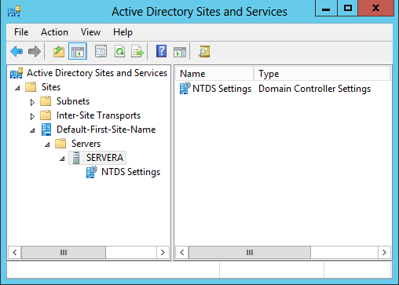
Create a Global Catalog Server
The Active Directory Sites and Services console

Slide 62
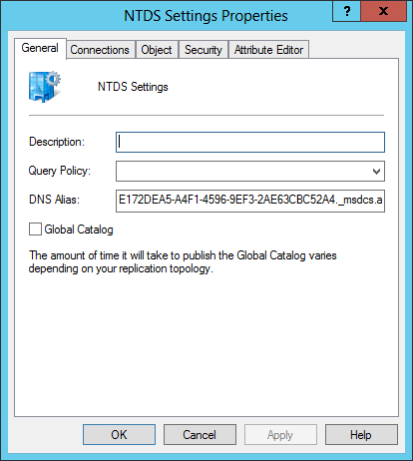
Create a Global Catalog Server
The NTDS Settings Properties sheet

Slide 63


Troubleshooting DNS SRV Registration Failure
The Domain Name System (DNS) is essential to the operating of Active Directory Domain Services.
A special DNS resource record (SRV) was created that enables clients to locate domain controllers and other vital AD DS services.
The dcdiag command can be used to confirm that a domain controller has been registered in the DNS.

Slide 64
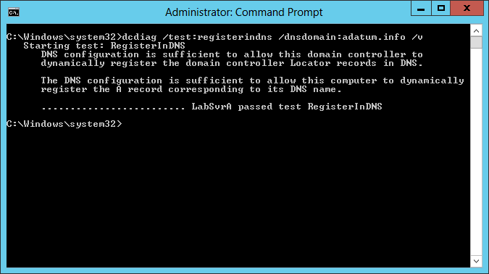
Troubleshooting DNS SRV Registration Failure
A successful dcdiag test

Slide 65

Lesson Summary
A directory service is a repository of information about the resources—hardware, software, and human—which are connected to a network. Microsoft first introduced the Active Directory directory service in Windows 2000 Server, and they have upgraded it in each successive server operating system release, including Windows Server 2012.
When you create your first domain on an Active Directory network, you are, in essence, creating the root of a domain tree. You can populate the tree with additional domains, as long as they are part of the same contiguous name space.
When beginning a new AD DS installation, the first step is to create a new forest, which you do by creating the first domain in the forest, the forest root domain.

Slide 66
Lesson Summary
In Windows Server 2012, it is now possible to install AD DS on a computer running the Server Core installation option and promote the system to a domain controller, all using Windows PowerShell.
Install from media (IFM) is an option that enables administrators to streamline the process of deploying replica domain controllers to remote sites.
There are two ways to upgrade an AD DS infrastructure. You can upgrade the existing down- level domain controllers to Windows Server 2012, or add a new Windows Server 2012 domain controller to your existing installation.

Slide 67
Lesson Summary
The global catalog is an index of all the AD DS objects in a forest that prevents systems from having to perform searches among multiple domain controllers.
The Domain Name System (DNS) is essential to the operating of Active Directory Domain Services. To accommodate directory services such as AD DS, a special DNS resource record was created that enables clients to locate domain controllers and other vital AD DS services.

Slide 68
Copyright 2013 John Wiley & Sons, Inc.
All rights reserved. Reproduction or translation of this work beyond that named in Section 117 of the 1976 United States Copyright Act without the express written consent of the copyright owner is unlawful. Requests for further information should be addressed to the Permissions Department, John Wiley & Sons, Inc. The purchaser may make back-up copies for his/her own use only and not for distribution or resale. The Publisher assumes no responsibility for errors, omissions, or damages, caused by the use of these programs or from the use of the information contained herein.

